Slide 1

B. Tech Major Project External Evaluation,
VIIIth Sem
Weight Training Pose Estimation
Presented by :
Sanjay Kumar Singh (2019001156)
Watan Raj Thakur (2019000475)
Akansha Raghuvanshi (2019558675)
Under the Supervision of:-
Dr. Ali Imam Abidi
DEPARTMENT OF COMPUTER SCIENCE & ENGINEERING
SHARDA SCHOOL OF ENGINEERING AND TECHNOLOGY
May, 2023
1

Slide 2
Approval from guide for the evaluation

Slide 3

Agenda
Introduction to the project
Motivation for the project
Problem Statements/Objectives of the Project
Literature Survey
Meeting details
Project Planning
Screenshot of the Approval of the Certificate of the Project Report
Project Module
Proposed System
Methodology used
Algorithms and framework
Quality of Project
Quality of Solution
Project Outcome
Accuracy
Proof of the Outcome

Slide 4
Teamwork Performed
S. No. | Team Member: | Role:
01. | Sanjay Kumar Singh | Requirements Gathering, project design, Development & Implementation, Paper Writing, Report Writing
02. | Watan Raj Thakur | Literature Survey and it’s Summary
03. | Akansha Raghuvanshi | Literature Survey and it’s Summary

Slide 5
Introduction
Human health is the complete state of physical, social and mental well-being and not merely the absence of any disease, illness or infirmity.
In current situation, human health has been on a steep decline. Number of people with some ailment or the other is increasing rapidly.
Most of this is attributed to lack of any physical exercise or a regime for the same.
Some who actually do take up the initiative to exercise regularly and primarily weight train most often than not find themselves new and unaware of the intricacies like correct posture and ‘form’ for an exercise and end up hurting themselves in the process.
In the process of this study, several such approaches have been reviewed which would assist the subject in assessing appropriate pose and form.
There are number of algorithms, which have been proposed recently for pose estimations. Several of these tools including YOLO-Pose and Google MediaPipe Pose have been proposed in recent years, and they have been proven to have surprisingly reliable performance in human body pose predictions.
Most gyms and similar facilities have a wide variety of equipment and experienced trainers for guidance regarding the correct posture and form. Unavailability of these equipment and trainers especially while setting up a workout regime at home during COVID-19 or similar housebound scenarios.

Slide 6

Motivation
As there are many people who are unable to complete the exercise correctly and accurately, a qualified guide is needed who can monitor them in real time while exercising. Different virtual systems have been developed to address this issue, yet some things still remain lacking. This technique is intended to help people exercise properly and at the right weight.

Slide 7
Problem Statements/Objectives of the Project
Many people are suffering from various types of severe injuries because they are unable to complete the exercise correctly. They can learn how to perform from a variety of online videos, but these videos cannot act as a real-time guide during a workout. This method may be useful to them as a real-time guide during workouts at home or in the gym, wherever they perform.

Slide 8
Literature Survey
S. No. | Author/Year | Methodology | Results | Remarks
1. | W. Ouyang et al., 2014 | DTW (Dynamic Time Warping), CNN model used was trained on the COCO [11] dataset for human pose estimation | IEEE conference on computer vision and pattern recognition | Here multi-source deep model in non-linearly integrates the three information sources: appearance scope, deformations and appearance mixture type.
2. | G. Dsouza et al., 2020 | One should focus on acquiring the model weights, which may be done online because to the availability of various example data sets for the general public. Model weights must be loaded into the network. The system must be able to read the user-uploaded video input. as a group of frames that we utilized as network input. The machine will then analyses crucial data and make predictions. Using the primary points, a stick figure or skeletal framework will be created. Calculations might be made to determine the angles between the various body components and the stick figure-like skeletal system. Using the angles that were established by obeying certain directions, a result can be attained. | Project execution is a fairly simplistic. The accuracy of the angels between them, using top-notch cameras and advanced graphics, joints and limbs may be made to look clear. | To improve quality of this paper project the camera should be of high mega pixels for good resolutions.
3. | A. Nagarkoti et al., 2019 | Used workout videos having a frame rate of 25f ps. User’s activity was recorded using a laptop and an external Webcam at a resolution of 1280X720. | Was able to detect errors in limp positions. Needed more fine-tuned data set for better result.
4. | M. Kocabas et al., 2018 | They evaluated the method on four different datasets (MPII Human pose dataset), (Human3.6M), (Penn Action), (NTU RGB+d) | 85.5% accurate on the NTU for 3d action recognition 97.4% accurate on the Penn action recognition 53.2% accurate on the Human3.6M action recognition 63.9% accurate on the MPII action recognition
5. | G. Taware et al., 2021 | The training data set consists of 60000 photographs, 25000 frames in which the user really completes the activity, and a few images of the same stance with different critical points. | As pose estimation using computer vision for various exercises and postures can be challenging, the poses and count repetitions for a select few exercises. It is not compatible to operate on a mobile Android or iOS application; rather, it is created as a cross-web application. In the real-time system, the program is unable to catch many people in the frame.

Slide 9
Literature Survey Contd.
6. | H. Pardeshi et al., 2022 | Greedy bipartite matching algorithm. and multi stage CNN for three significant stages | Works with 86.534% accuracy | Using the greedy bipartite matching algorithm
7. | H. Xiong et al., 2020 | It operated using reliable workout analysis based on robust vision. | It recognizes improper movements and does not take timing into account. Consequently, don't give the user timely feedback.
8. | S.K. Yadav et al., 2019 | Recognize various yoga poses using deep learning algorithm and data sets of 6 yoga asana is used. Yoga pose detection in real-time videos using CNN and LSTM. | It can be used on a portable device for self-training and real-time predictions.
9. | Y. Gu et al., 2019 | Utilized deep leaning for human posture estimation and an interactive computer vision-based system at home to complete physical therapy. | They were unable to create a way of algorithm which, provides more specific evaluation of the patient’s progress or offer users the option of viewing the side of the object.
10. | Chen & Yang, 2018 | Deep neural networks and OpenPose were utilized to estimate poses, while machine learning and heuristic-based models were employed to calculate performance results through comparisons. | It only functions on web-based Windows and Linux computers that use GPU technology.
11. | Z. Cao et al., 2019 | It did on single-person and multi-person pose estimates. They do inference on a single person based on a variety of local observations of various body parts. Multi-person employed a top-down approach to first identify persons and then separately assess each person's stance. | This only executes on images; it cannot be applied to videos.

Slide 10
Literature Survey Contd.
12. | Q. Dang et al., 2019 | The two types of single-person pose estimation are regression-based approach and heatmap-based approach. Top-down approach and bottom-up approach | Human pose estimation can still be improved and For real-time prediction, algorithms still perform too slowly.
13. | F. Sajjad et al., 2017 | Here many various methods for the human pose recognition, When compared to identifying which, one works better and performs correct in recognitions |  | Different datasets are used for different parts of body, some algorithms used in real time videos whereas some are used for images and some for videos
14. | Toshev & Szegedy, 2014 | Used Deep Neural Networks (DNN) and formed a DNN-based regression problem towards body joints. | were able to capture context (where some of the body parts were barely visible) in a holistic manner
15. | Khan & Wan, 2018 | They have discussed about first pictorial Structures, Global Analysis of Structures, and Greater Visual Simulator for Pictorial Structures, depose, Image-dependent pair-wise relations in DNN, Combining a localized perspective with a holistic one, Hourglass stacked, Multi-Context Focus, Network with Multi-Scale Structure Awareness | Explains how these methods are still being used
16. | M.R. Sonawane et al., 2022 | They applied image processing in their application to compute height and video processing with the aid of the Open CV Library to identify exercises performed by a user. Users will receive exercise recommendations based on their height and weight and BMI. Additionally, they separated BMI into five groups: underweight, normal, overweight, obese, and extremely obese. |  | a very simple application which used Open CV library for video processing And divided body Mass Index (BMI) into categories.

Slide 11
Literature Survey Contd.
17. | RA Güler et al., 2018 | Introduced DensePose-COCO, a sizable collection of ground-truth image-surface correspondences and developed unique architectures for recovering highly-accurate dense correspondences between images and the body surface in many frames per second |  | Were able to recover highly accurate dense correspondence between images and the body surface in multiple frames per second
18. | D. Tome et al., 2017 | For the purpose of improving both tasks have created an all-encompassing formulation that takes into account 2D joint estimation and 3D pose reconstruction for the problem of 3D human posture estimate from a single raw RGB image simultaneously. They used a combined strategy that combines probabilistic understanding of human’s 3D position along with CNN architecture’s multi-stage via application of understanding of conceivable 3D landmark locations to focus finding for more suitable 2D places. The entire procedure is trained from beginning to end, is incredibly effective, and produces cutting-edge results on Human 3.6M that surpass earlier methods for both 2D and 3D mistakes.
19. | K. Sun et al., 2019 | They have started from a high -resolution subnetwork as the first stage, then gradually add high-to-low resolution subnetworks, and connected multiresolution subnetworks. |  | As a result, the predict key-point heat map is potentially more accurate and spatially more precise.
20. | Patel & Kalani et al., 2021 | In this paper, they have used CNN and compare and summarized various deep learning models for pose estimation of a single person and multi-person. |  | Deep convolutional neural networks are successfully applied to learn various computer vision Tasks.
21. | C. Sun et al., 2017 | This paper takes a step towards clearing the clouds of mystery surrounding the relationship between ‘enormous data’ and visual deep learning. THEY have used e JFT-300M dataset, which has more than 375M noisy labels for 300M images,

Slide 12
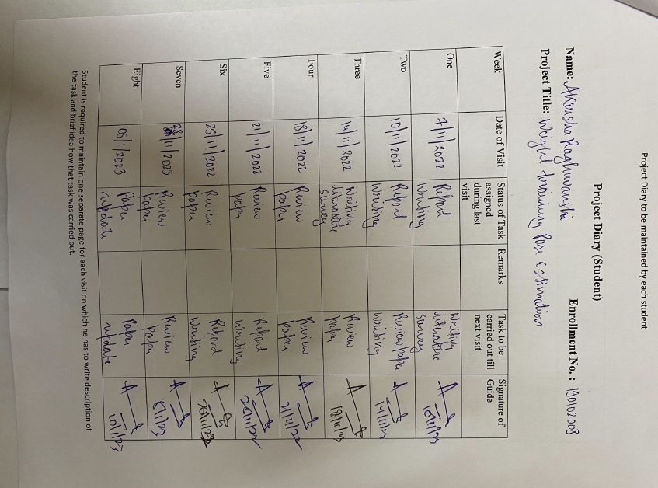
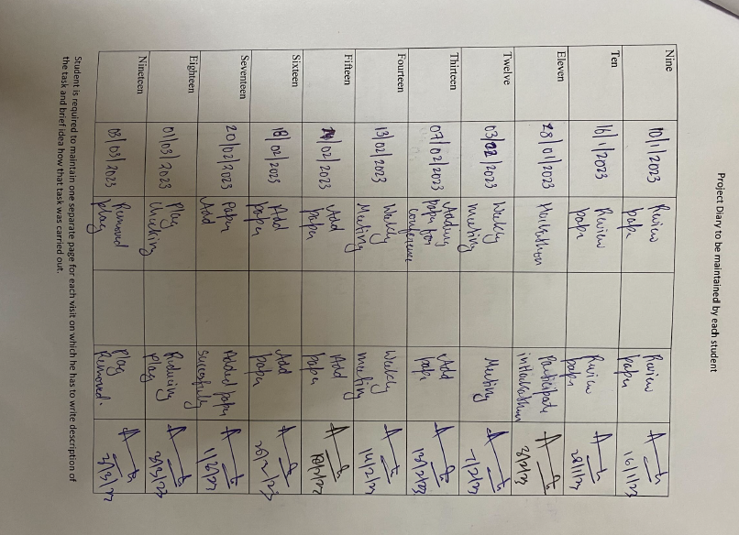
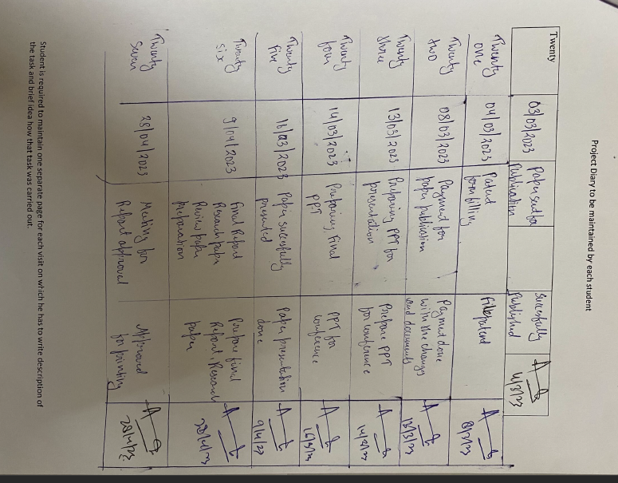
Meeting details

Slide 13
Project Planning
Choose A Topic & Read Research Paper
Find the Novelty to Work On
Build Outline of Project
Plan Presentation and Confirmations
Project Implementation & Execution

Slide 14
Screenshot of the Approval of the Certificate of the Project Report

Slide 15
Project Modules
The project is divided into 4 modules:
User’s Inputs
Recommendations System
Setting the Recommended angles
Curl counters

Slide 16
Project Modules
Process and Recommendation:
Process these data and find appropriate weight and angle for recommendations
User’s Inputs:
It takes basic data from user
Setting the Recommended Angles :
Set the recommended angle to system for curl measuring
Curl Counters:
Starts Counting the curl once user reach to appropriate angles set

Slide 17
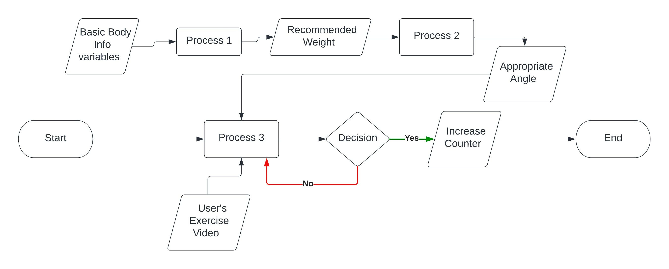
Proposed System
Fig.1 Project Basic planning Design
In the above figure 1, User provide his/her basic body information's and on the basis of those data, system will do the Process 1, and then recommend them an appropriate weight for doing exercise and then with the help of recommended weight and basic info. of users body, the output gives an appropriate angle for workout.

Slide 18
Methodology used
With the rapid development in the field of deep learning for various tasks including image segmentation or object detection, there are numbers of different techniques, which has brought significant advances and performance gains in pose estimation tasks:
BlazePose: it’s much faster technique to predict two additional virtual keypoints, which firmly detect human body center, rotation and scale as a circle.
Cosine Similarity: It is used to measure 2 non-zero vectors to find inner angle between them

Slide 19
Methodology used contd.
In this project, BlazePose is going to be used to track the limbs and joints as it is light and executing with good accuracy. It is inspired from BlazeFace model, which is light and used in MediaPipe Face Detection.
It consists of two machine learning models:
A Detector- cut out the human region from the image,
An Estimator- takes a 256*256 resolution image and detect person as in image and outputs the keypoints

Slide 20
Algorithms and framework
Framework used in this project is MediaPipe, which is cross-platform pipeline to build custom machine learning solutions for live and streaming media( computer vision).
It finds 32 landmarks of body with different joints & positions as node for body pose detection. We use further 6 nodes landmarks (no. 11,12,13,14,15 &16) named as left_sholder, right_sholder, left_elbow, right_elbow, left_wrist, right_wrist for measuring angles while performing exercise.

Slide 21

Methodology used contd.

Slide 22
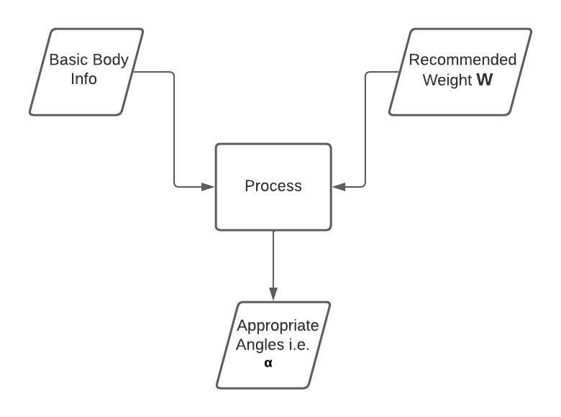
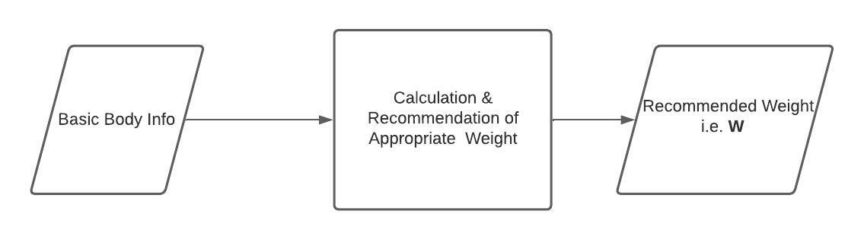
Proposed System Contd.
Now with the appropriate angle and users exercise performing video as input then process 3 executes, where detection of body is done by MediaPipe and then there will be formations of node at joint and edges to join them as bone, angle between arm and forearm will be find and then each repetitions of exercise of one complete cycle, it will increase the counter by 1.
Fig 2. Process 1 for weight recommendation
Fig 3. Process 2 for Appropriate angle

Slide 23
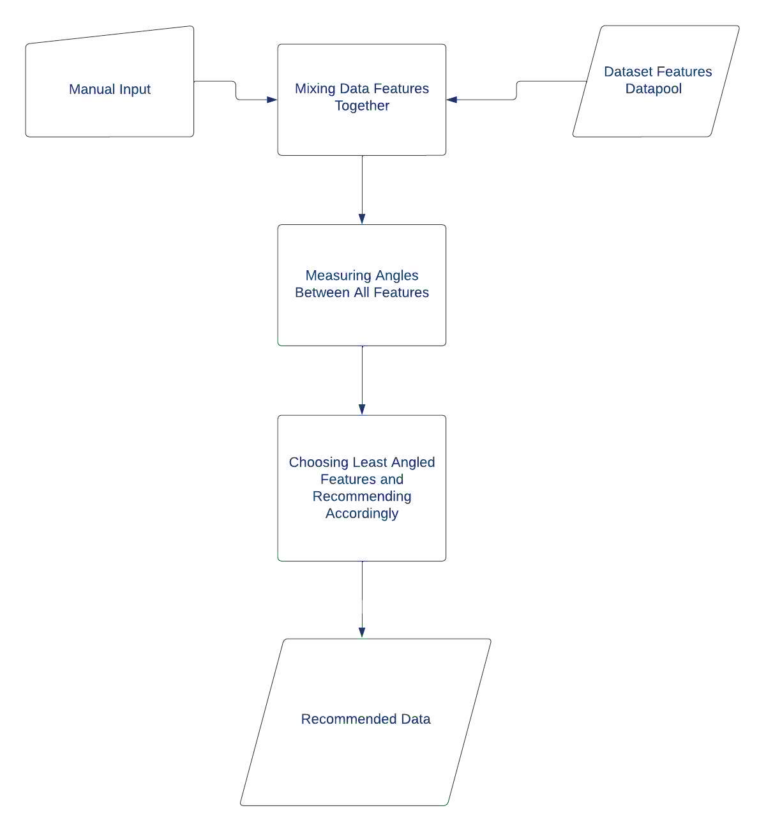
Proposed System Contd.
Fig 4. Complete Recommendations Process Working

Slide 24
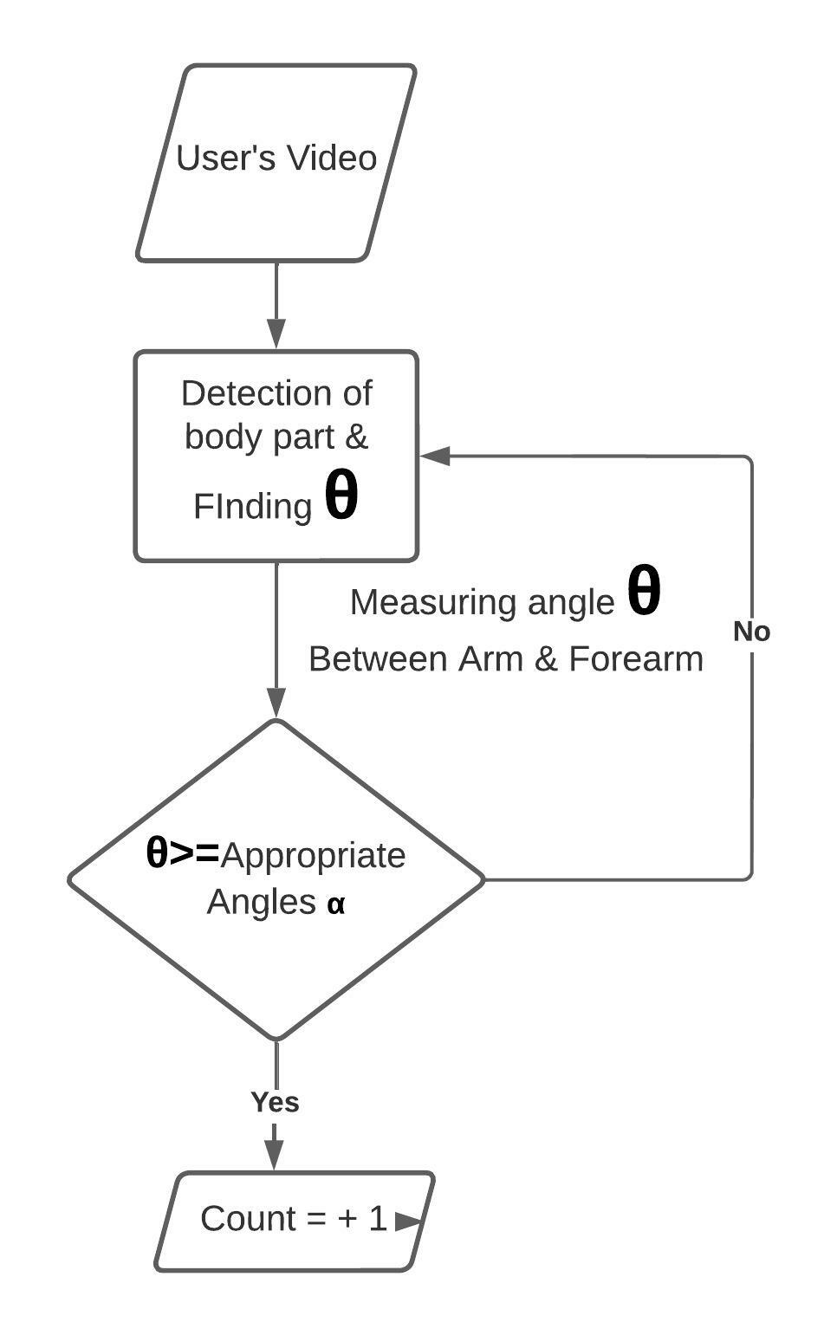
Proposed System Contd.
Fig 5. Process 3 with complete executions

Slide 25
Quality of Final Project Report
The system is formed with 3 different modules and yet to update for finalizations:
Weight recommendation
As the users having different body strength with different body factor, therefore, they needed to pick appropriate weight for performing exercise (i.e. Bicep curl), which will ultimately produce good results
Appropriate Angle Finding
Varying in weight for performing exercise with respect to user also need to find appropriate angle range for good results and healthy exercise.
Executing process to count the repetitions
When all user meets the appropriate angle with recommended weight, then the exercise one repeat gets complete each time, hence the counter give the number of performed exercise repetitions.

Slide 26
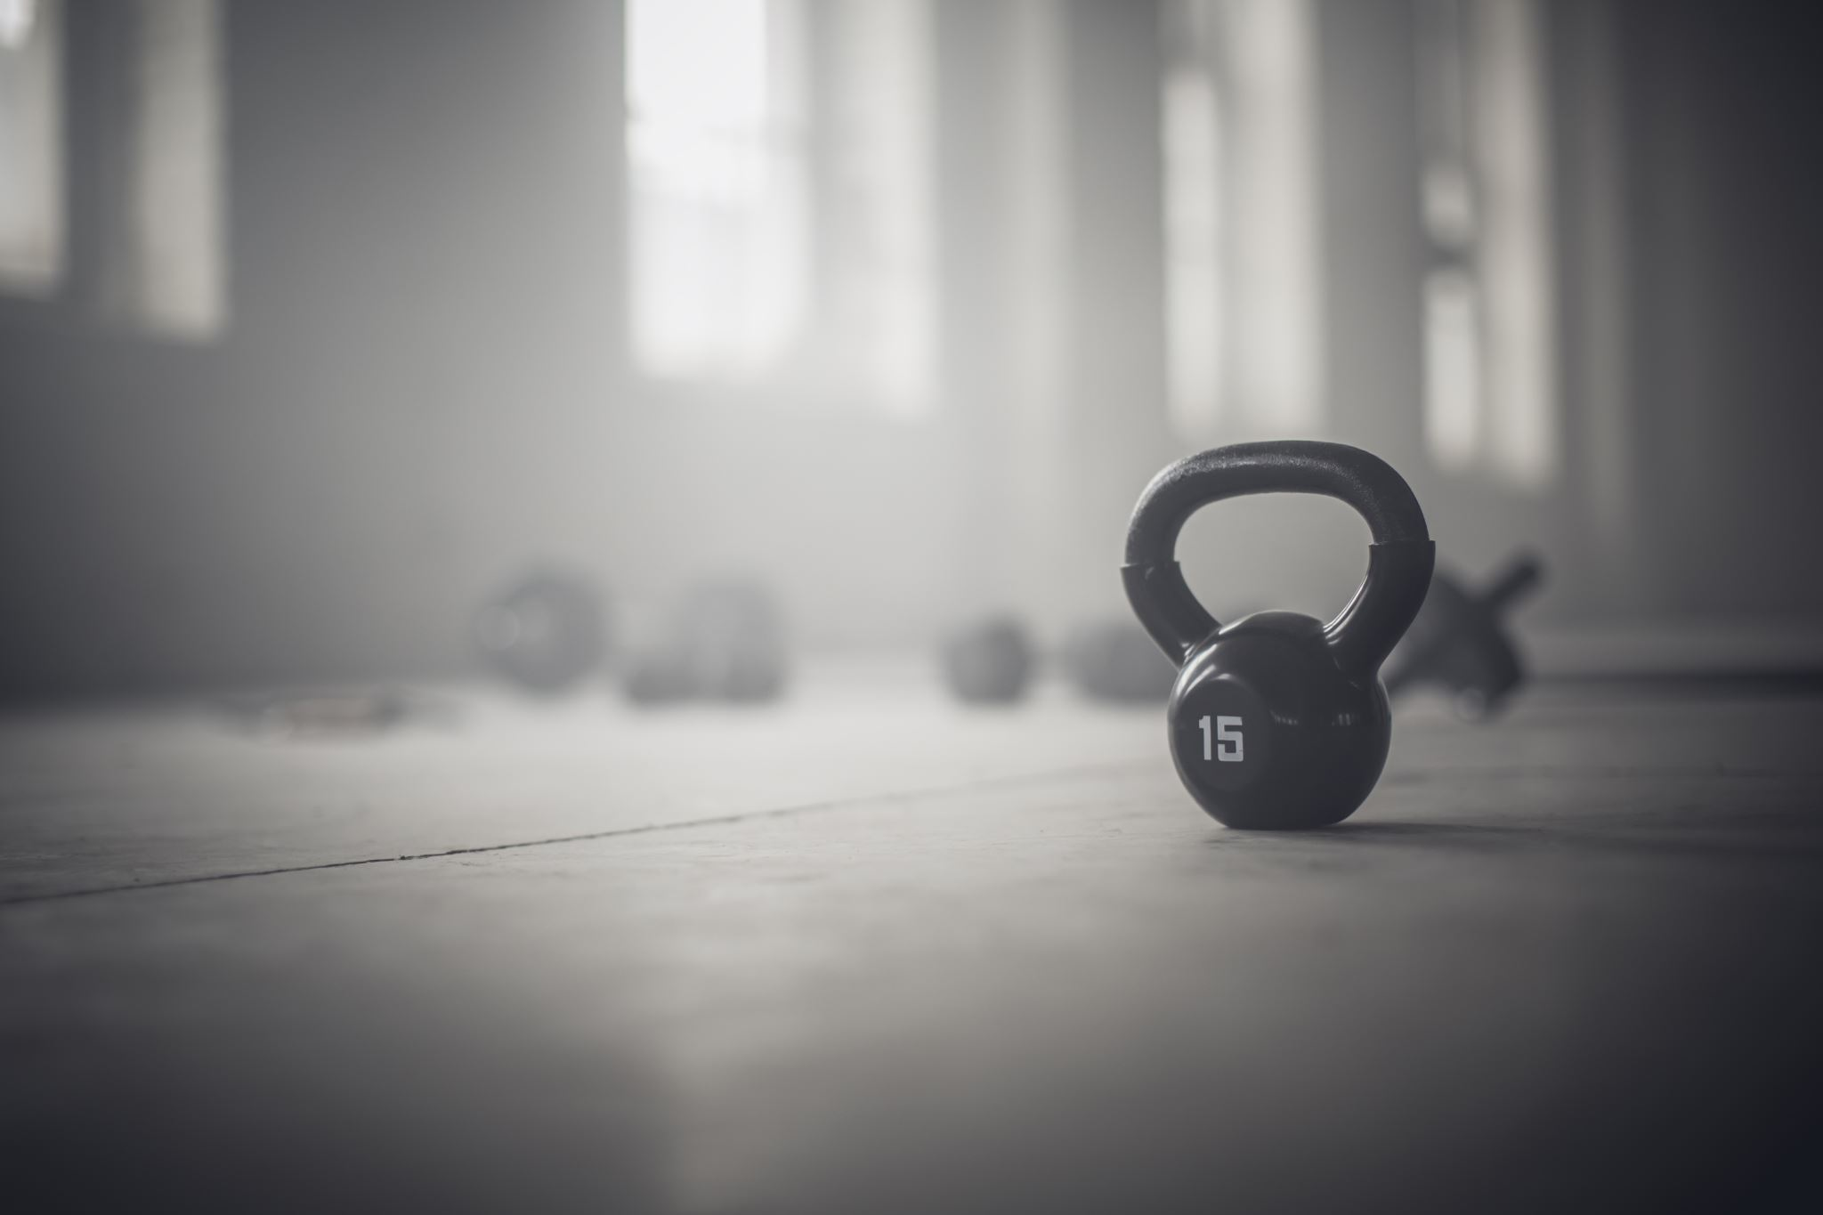
QUALITY OF SOLUTION
Operational feasibility:
It can be easily performed and operated with the help of any camera/image acquisition device from anywhere.
Scheduling feasibility:
It helps in calibrating workout postures on the basis of time schedule of the users even they are out of the home or place where they can’t reach for exercise.
Economic Feasibility:
It will be free of cost workout guide for the people even who are not able to pay the high amount of fees to the trainer and gym.

Slide 27
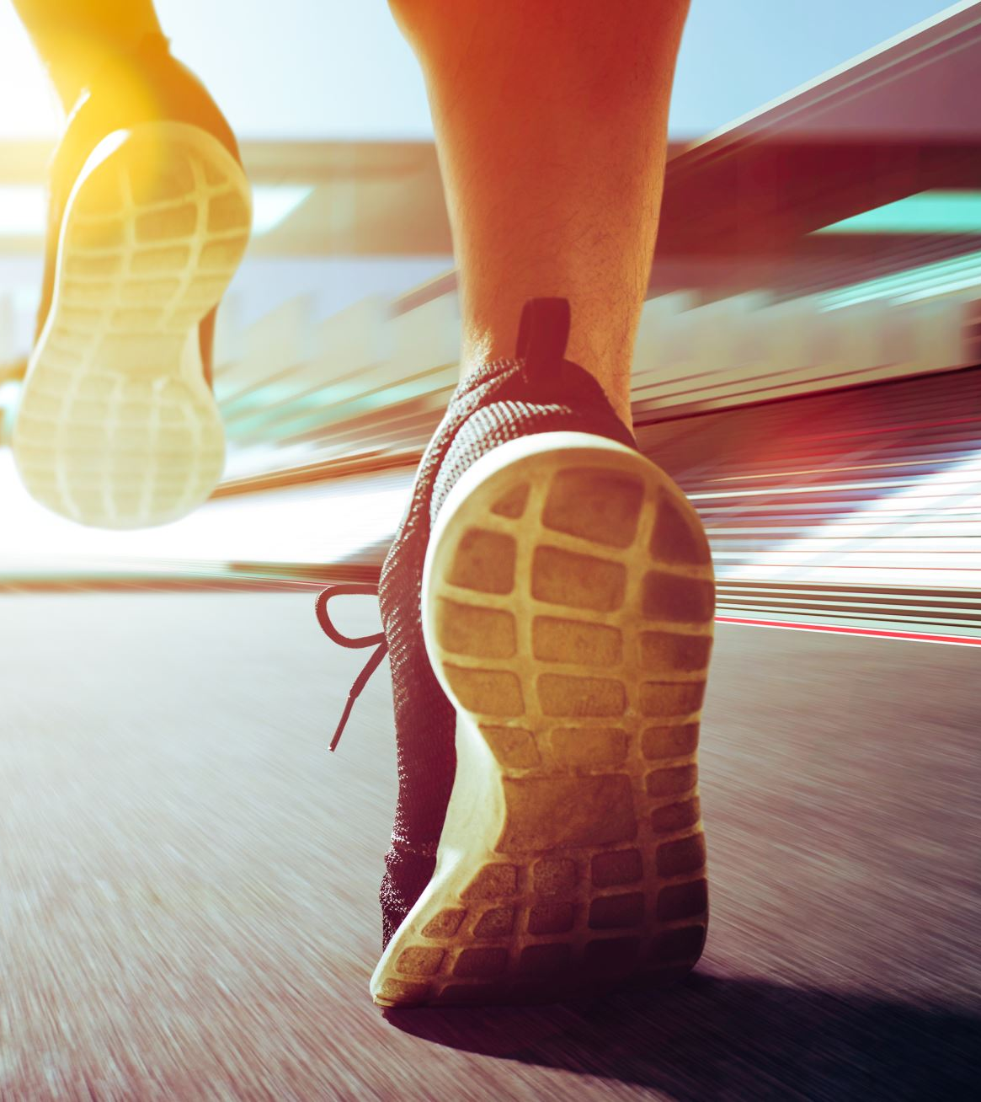
QUALITY OF SOLUTION contd…
The aspect of this system is it combines fitness and technology to successfully bring an advancement in exercise tracking and acting as personal trainer to the users without requiring the help of actual trainer in person.
It brings flexibility to the user to perform the exercise safely and appropriately irrespective of place at any time anywhere throughout the day during availability of free time. It recommends the appropriate weight with appropriate angles, which lead to better outcome results of users.

Slide 28
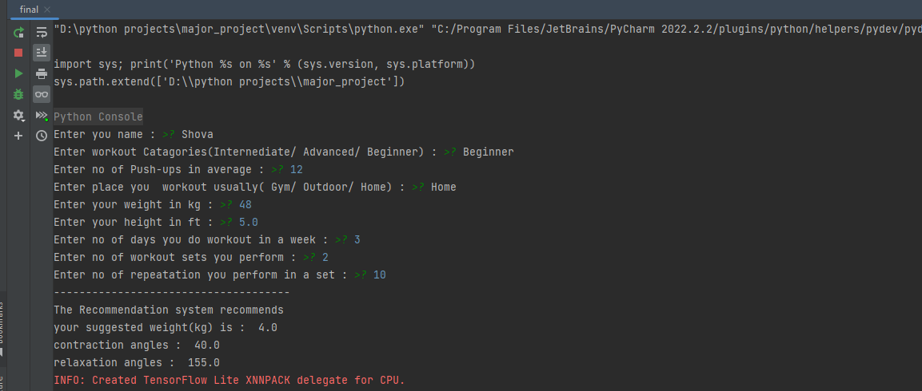
Projects Outcome
Fig 6. Recommended Data on the basis on User’s Input

Slide 29
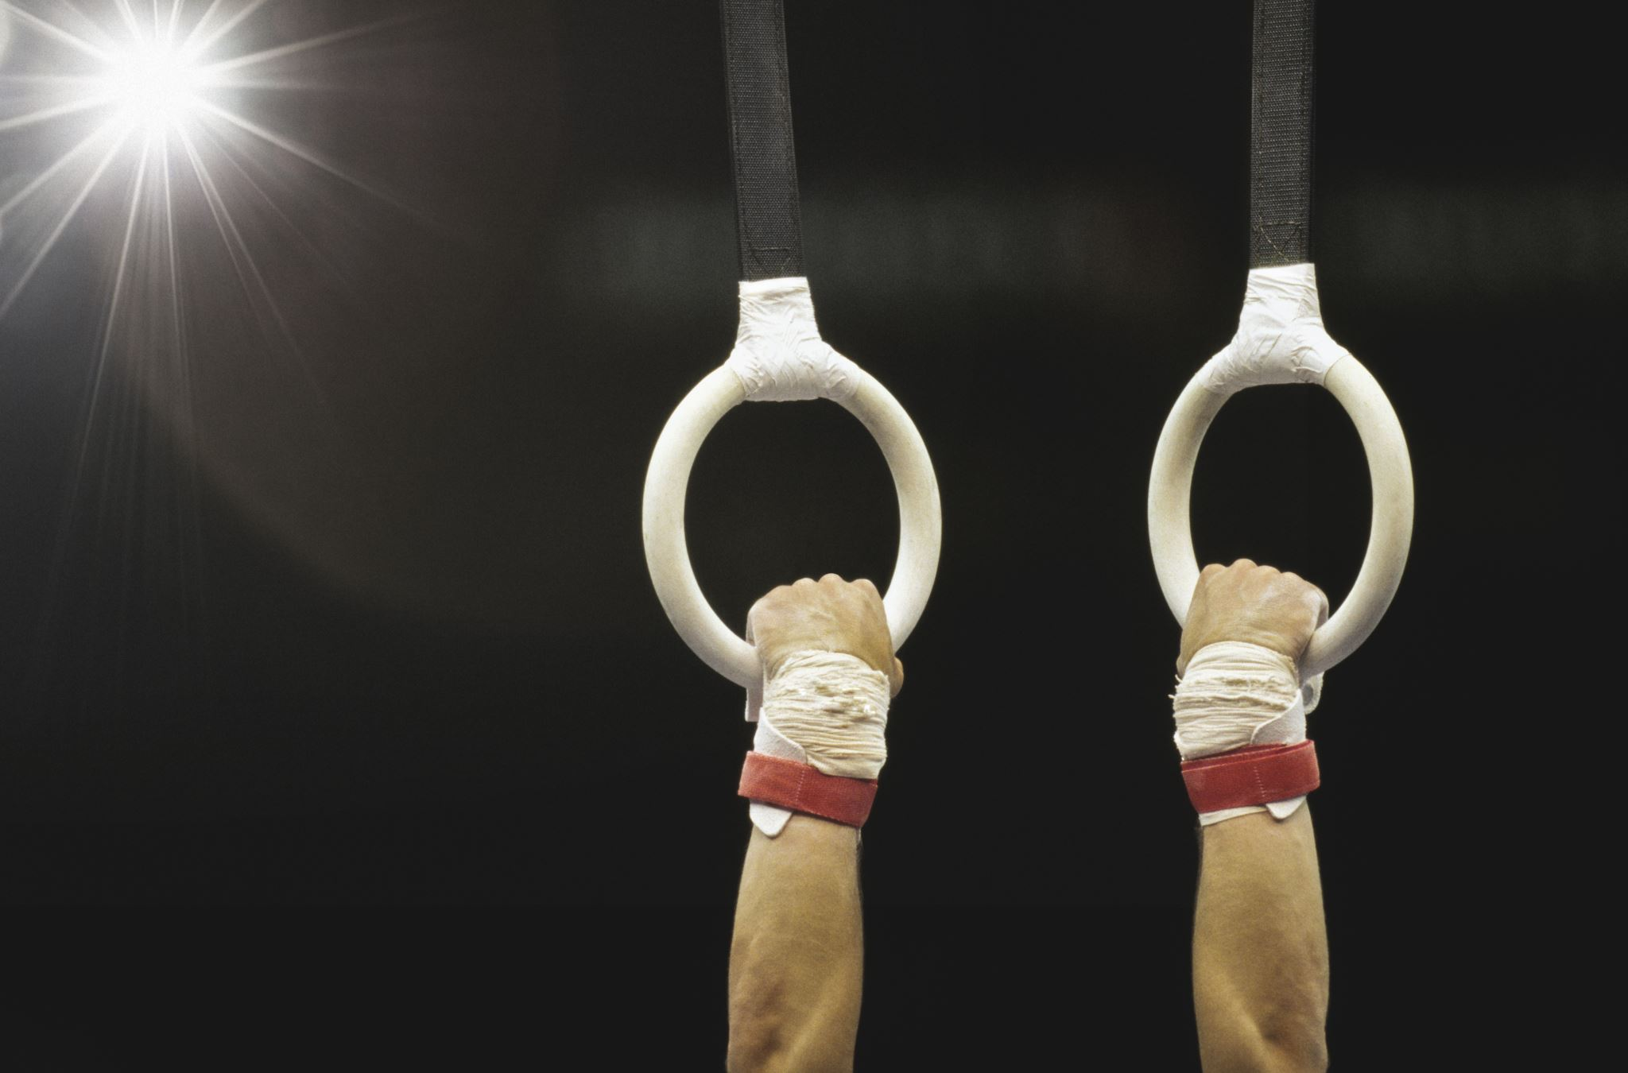
Projects Outcome contd.
The recommendation data provided by the system is based on the user's input, which is compared with the dataset provided during the system's training. The system is trained using a large dataset to identify patterns and make accurate recommendations. When a user inputs their workout routine, sets, body weight, and level of workout, the system compares this input to the dataset it has been trained on. The system then uses algorithms to identify the most similar workout routines in the dataset and recommends the appropriate weight, angle of contraction and relaxation, and other related details to the user.

Slide 30
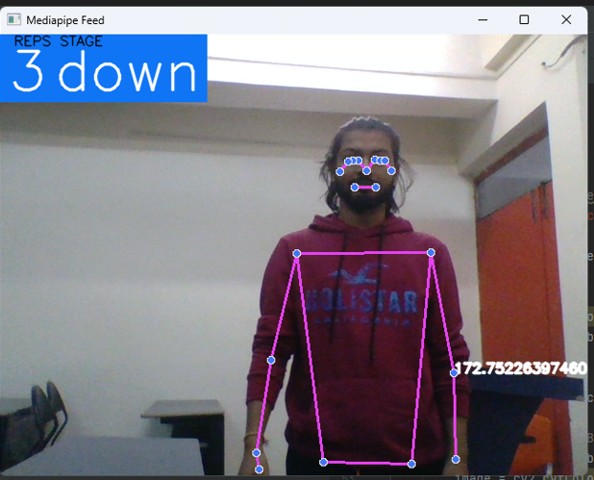
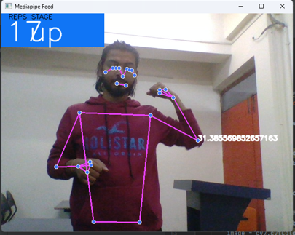
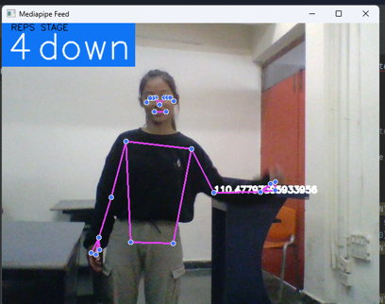
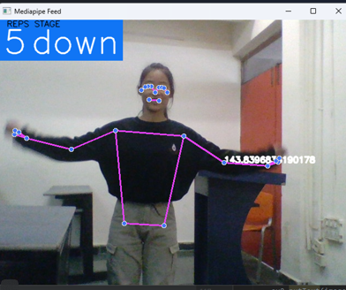
Projects Outcome
Fig 7. Results of Current Model with Test Provided Data

Slide 31
Projects Outcome contd.
In the above figure 4, there are 4 different images with different angles between arm and forearm, and also there is counter showing repetitions and stage of doing exercise to do hand down or up for doing bicep curl.

Slide 32
Accuracy
Accuracy of “Recommendation System” is not determinable at this moment as it just recommends the angles and weight based on input features and dataset it has. However, the recommendation system will be more precise whenever the dataset gets enlarged. Additionally, the accuracy of body landmarks recognition mostly depends on the camera hardware and environments. However, it performs quite well even with lower performing devices with good results

Slide 33

Proof of the Outcome

Slide 34

Certificate of Participations

Slide 35

THANK YOU

